Slide 1
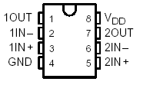
3.1V (Mote battery)
Mote RxD line
10KΩ
10KΩ
Khepera TxD line

